Slide 1

MONEY LAUNDERING DETECTION USING MACHINE LEARNING METHODS
Date: 28 May 2021
K.THANMAI : 17WH1A0513
G.SRIVIDYA : 17WH1A0534
G.NYMISHA : 17WH1A0530
Internal Guide: Mr. K.NARESH
Designation: Assistant Professor
Department of Computer Science & Engineering
BVRIT HYDERABAD College of Engineering for Women

Slide 2
PROJECT INTRODUCTION
Domain:
Datamining, ML
Abstract:
Money laundering is the process of taking cash earned from illicit activities such as drug trafficking, and making the cash appears to be earnings from legal business activity. The money from the illicit activity is considered dirty and the process “launders” the money to make it look clean.
BVRIT HYDERABAD College of Engineering for Women

Slide 3
DATASET
Dataset Description:
This is synthetic dataset generated using the simulator called Pay Sim which contains all transactions.
Attribute Description
step maps a unit of time in the real world
type CASH-IN, CASH-OUT, DEBIT, PAYMENT and TRANSFER
amount amount of the transaction in local currency
nameOrig customer who started the transaction
oldbalanceOrig initial balance before the transaction
newbalanceOrig new balance after the transaction
nameDest customer who is the recipient of the transaction
oldbalanceDest initial balance recipient before the transaction
newbalanceDest new balance recipient after the transaction
isFraud This is the transactions made by the fraudulent agents inside the simulation
isFlaggedFraudThe business model aims to control massive transfers from one account to another and flags illegal attempts
BVRIT HYDERABAD College of Engineering for Women

Slide 4
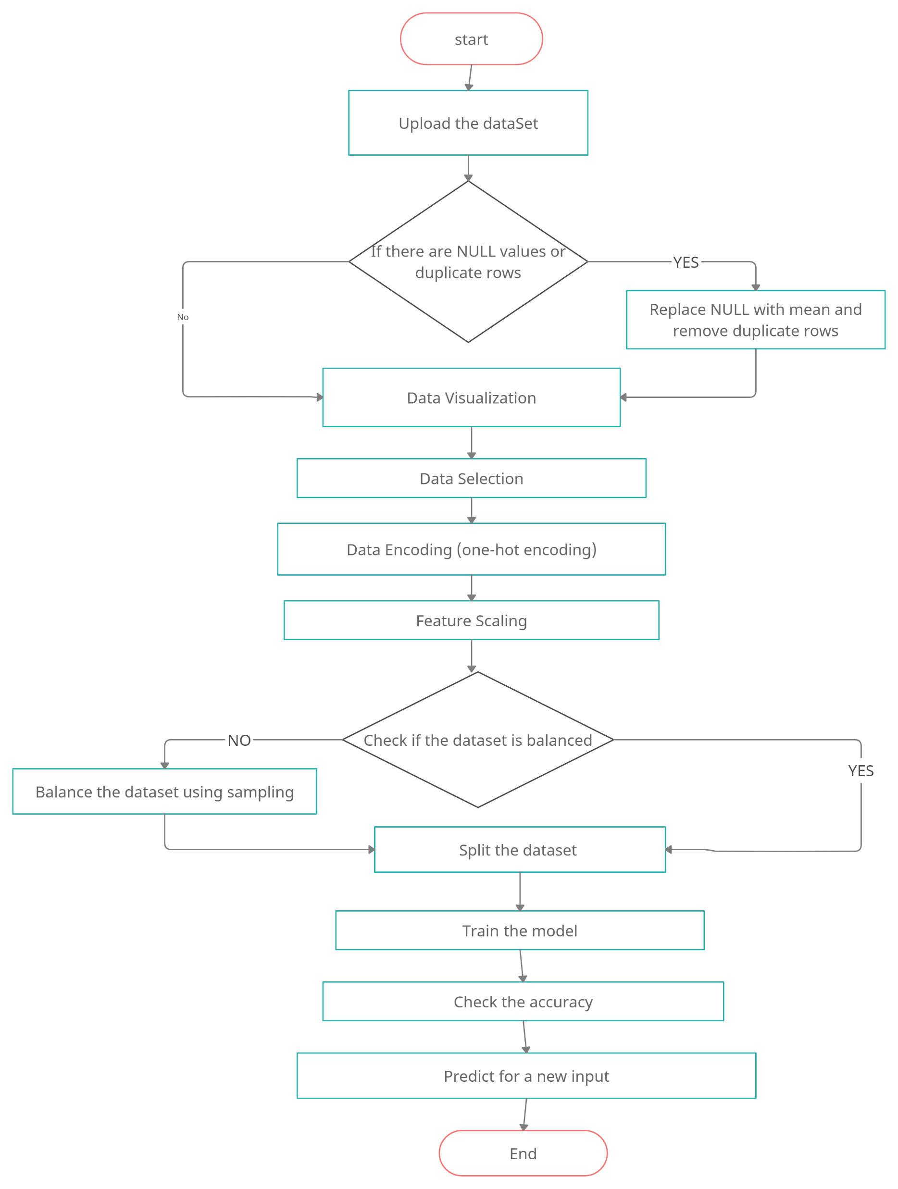
DESIGN AND WORKFLOW
BVRIT HYDERABAD College of Engineering for Women

Slide 5
TECHNOLOGY STACK
Machine Learning
Tkinter
Python Programming Language
Anaconda - Jupyter notebook
Required Python Packages:
numpy
pandas
keras
sklearn
tkinter
matplotlib
Imblearn
BVRIT HYDERABAD College of Engineering for Women

Slide 6
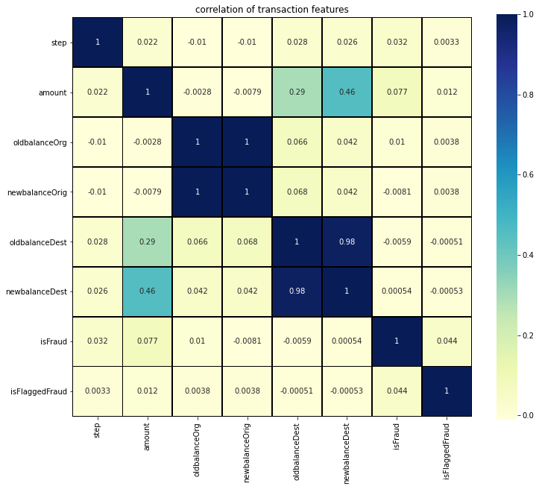
DATA VISUALISATION
BVRIT HYDERABAD College of Engineering for Women

Slide 7
ONE-HOT ENCODING
 | step | Type | Amount | nameOrig | oldbalanceOrg | newbalanceOrig | nameDest | oldbalanceDest | newbalanceDest | isFraud | isFlaggedFraud
0 | 1 | PAYMENT | 9839.64 | C1231006815 | 170136.0 | 160296.36 | M1979787155 | 0.0 | 0.0 | 0 | 0
1 | 1 | PAYMENT | 1864.28 | C1666544295 | 21249.0 | 19384.72 | M2044282225 | 0.0 | 0.0 | 0 | 0
2 | 1 | TRANSFER | 181.00 | C1305486145 | 181.0 | 0.00 | C553264065 | 0.0 | 0.0 | 1 | 0
 | step | Amount | oldbalanceOrg | newbalanceDest | isFraud | isFlaggedFraud | CASH_IN | CASH_OUT | DEBIT | PAYMENT | TRANSFER
0 | 1 | 9839.64 | 170136.00 | 0.00 | 0 | 0 | 0 | 0 | 0 | 1 | 0
1 | 1 | 1864.28 | 21249.00 | 0.00 | 0 | 0 | 0 | 0 | 0 | 1 | 0
2 | 1 | 181.00 | 181.00 | 0.00 | 1 | 0 | 0 | 0 | 0 | 0 | 1
BVRIT HYDERABAD College of Engineering for Women

Slide 8
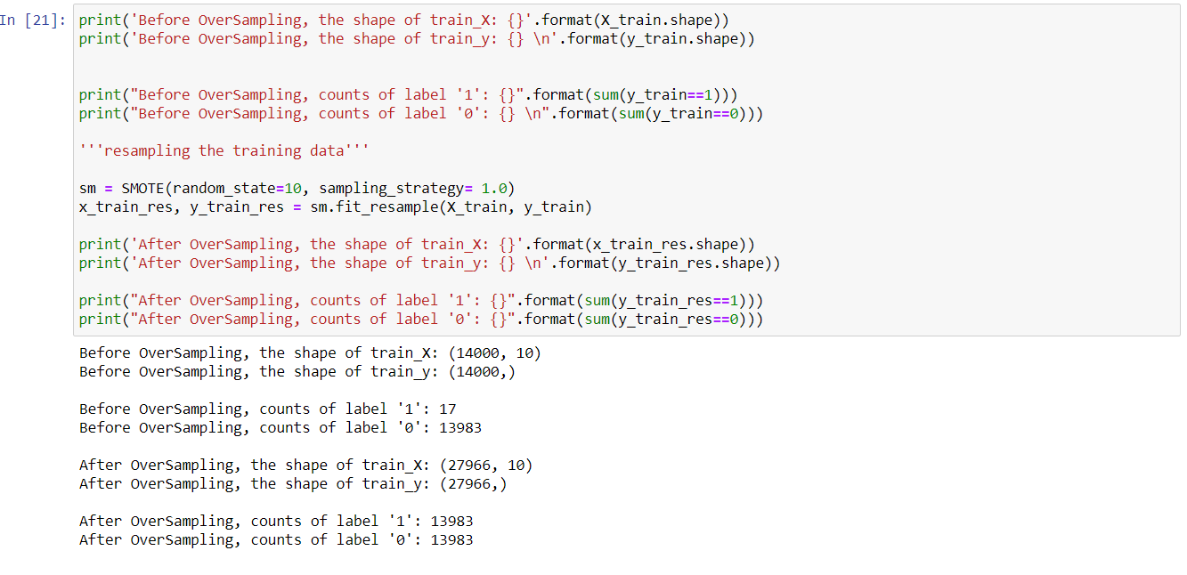
SAMPLING
BVRIT HYDERABAD College of Engineering for Women

Slide 9
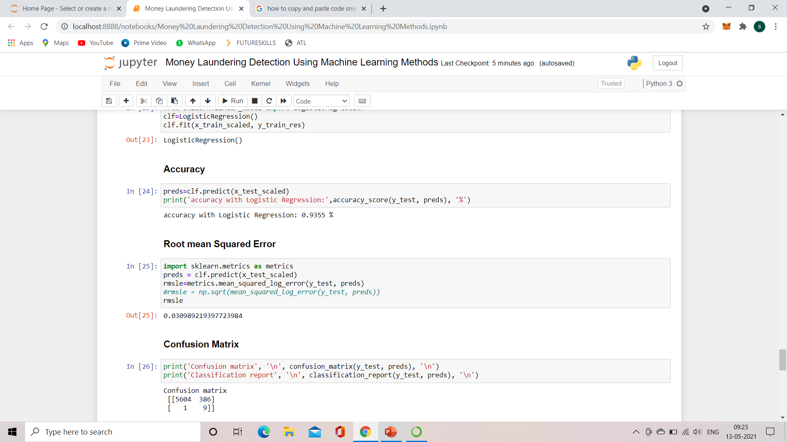
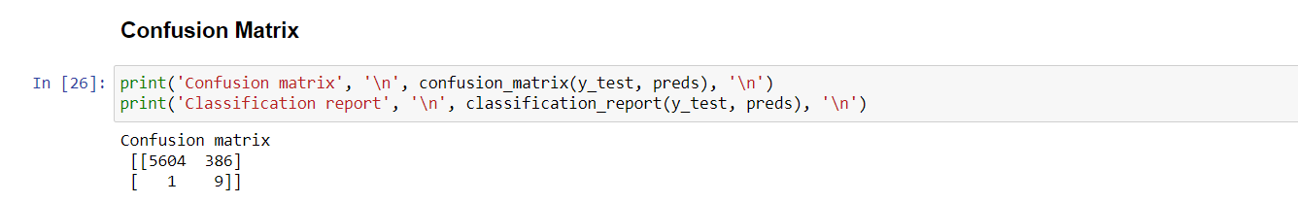
LOGISTIC REGRESSION
BVRIT HYDERABAD College of Engineering for Women

Slide 10
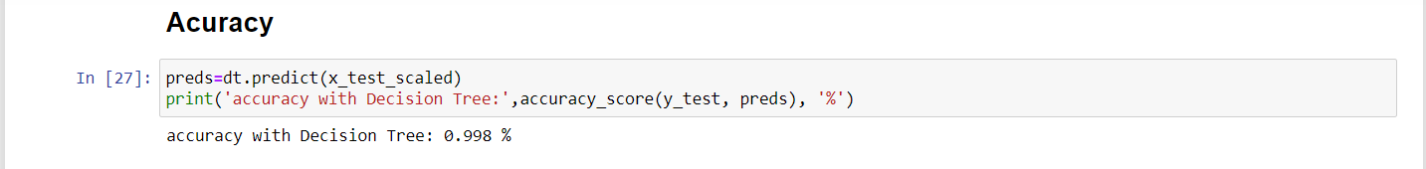
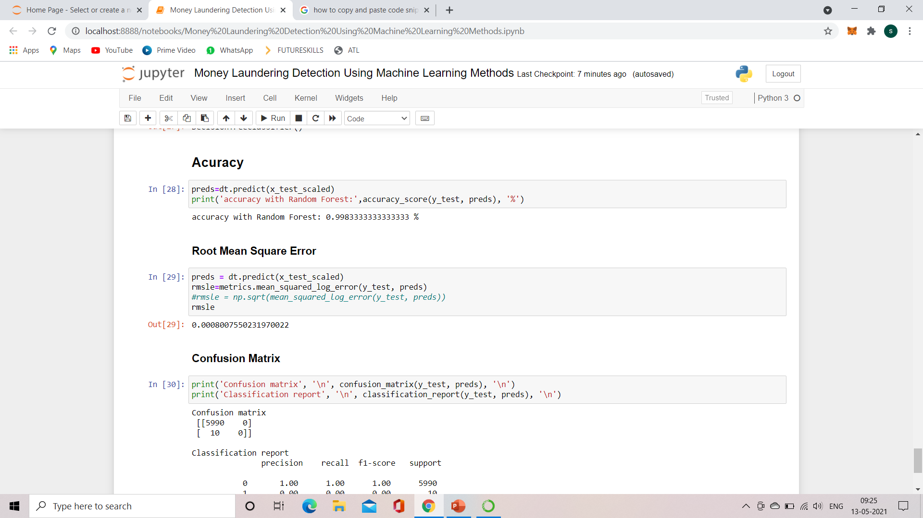
DECISION TREE
BVRIT HYDERABAD College of Engineering for Women

Slide 11
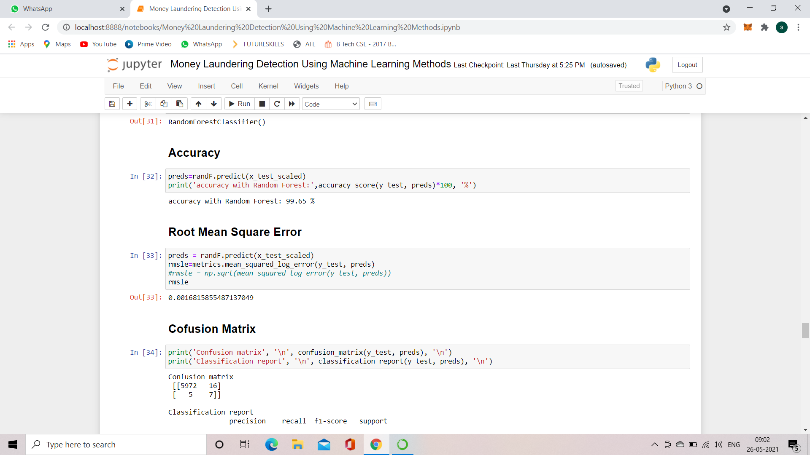
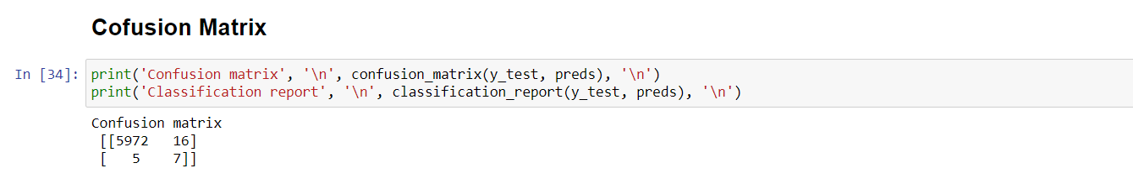
RANDOM FOREST
BVRIT HYDERABAD College of Engineering for Women

Slide 12
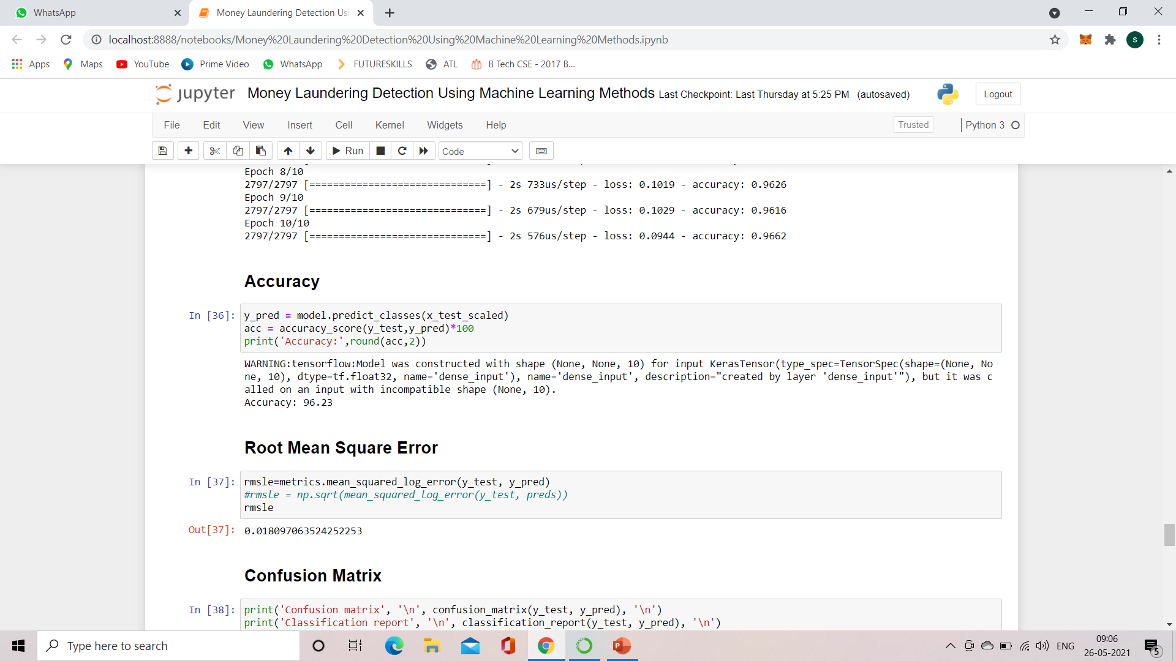
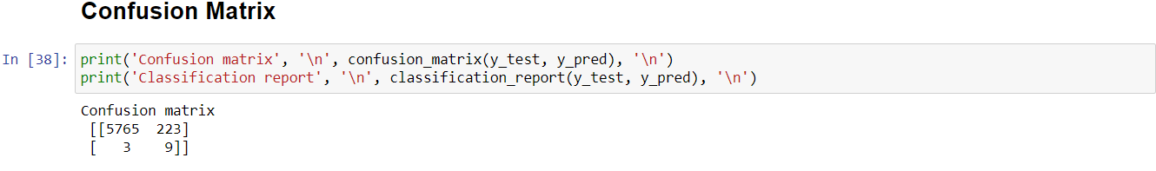
NEURAL NETWORKS
BVRIT HYDERABAD College of Engineering for Women

Slide 13
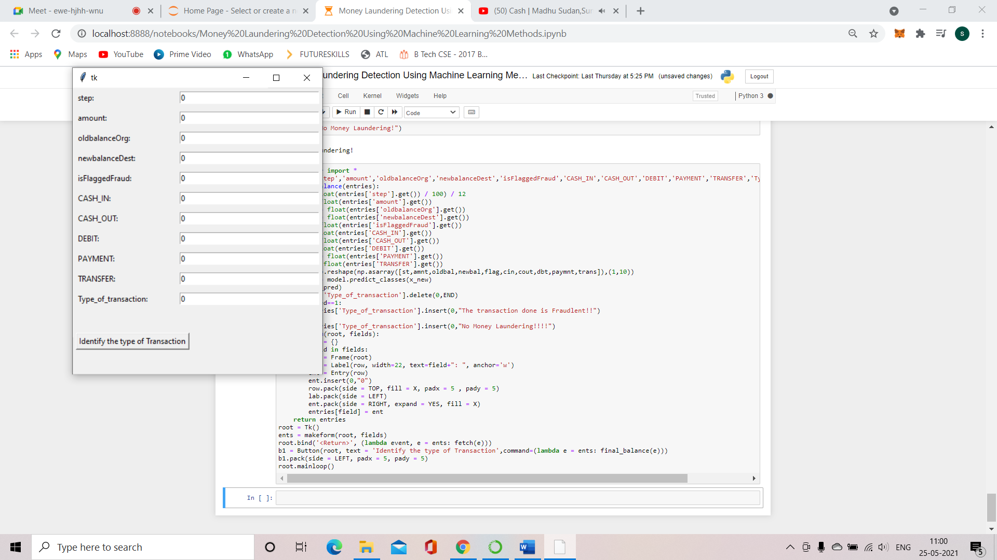
SAMPLE USER INTERFACE
BVRIT HYDERABAD College of Engineering for Women

Slide 14
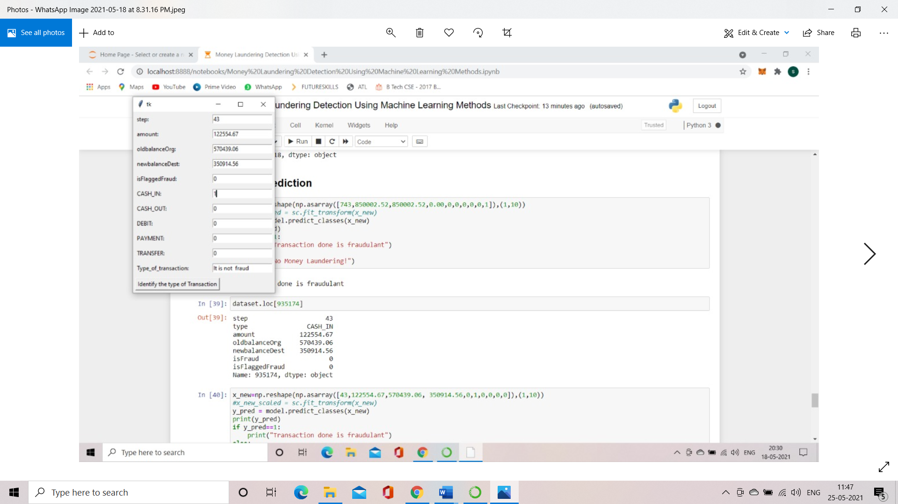
TEST INPUT - I
TEST INPUT 1:
Step 43
Type CASH_IN
Amount 122554.67
oldbalanceOrg 570439.06
newbalanceDest 350914.56
isFlaggedFraud 0
EXPECTED OUTPUT:
It is not fraud
BVRIT HYDERABAD College of Engineering for Women

Slide 15
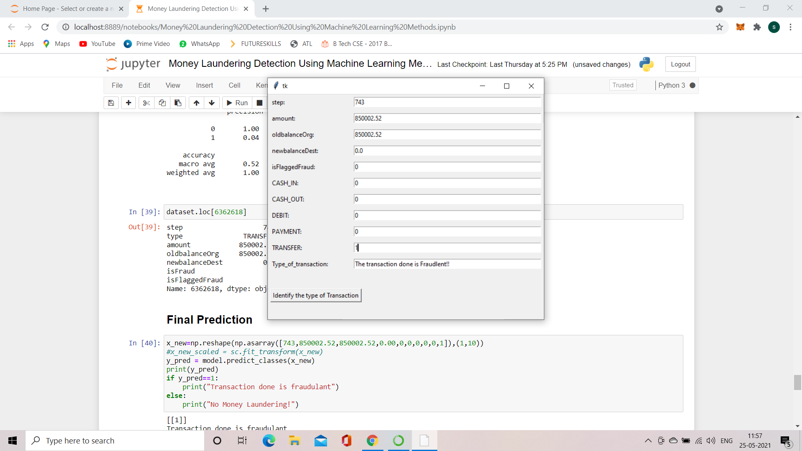
TEST INPUT - II
TEST INPUT 2:
Step 743
Type TRANSFER
Amount 850002.52
oldbalanceOrg 850002.52
newbalanceDest 0.0
isFlaggedFraud 0
EXPECTED OUTPUT:
The transaction done is fraudulent!!
BVRIT HYDERABAD College of Engineering for Women

Slide 16
TEST CASES
Testcase ID | Test Scanario | Expected Result
TC01 | Check whether all the required fields are given input | compare number of inputs with expected inputs
TC02 | Check whether the inputs are matching with datatypes | Check the input type with expected type
TC03 | Check whether find the type of transaction button is working | redirected to a function on clicking the button
TC04 | Check whether the actual output is matching with Predicted output | Print the error rate of the trained model
BVRIT HYDERABAD College of Engineering for Women

Slide 17
SYSTEM SPECIFICATIONS
ENVIRONMENT | SPECIFICATIONS
HARDWARE | Processor – i5 Processor Memory(RAM) - 4 GB and more
SOFTWARE | Python3 OS - Windows 10 Anaconda-Jupyter notebook
BVRIT HYDERABAD College of Engineering for Women

Slide 18
References
Base Paper:
https://www.ripublication.com/ijaer17/ijaerv12n20_120.pdf
Reference Papers:
http://www.ijarset.com/upload/2015/august/1_IJARSET_manjunath.pdf
https://www.researchgate.net/publication/43508814_Knowledge-based_anti-money_laundering_A_software_agent_bank_application
BVRIT HYDERABAD College of Engineering for Women

Slide 19
Thankyou
BVRIT HYDERABAD College of Engineering for Women

